Slide 1
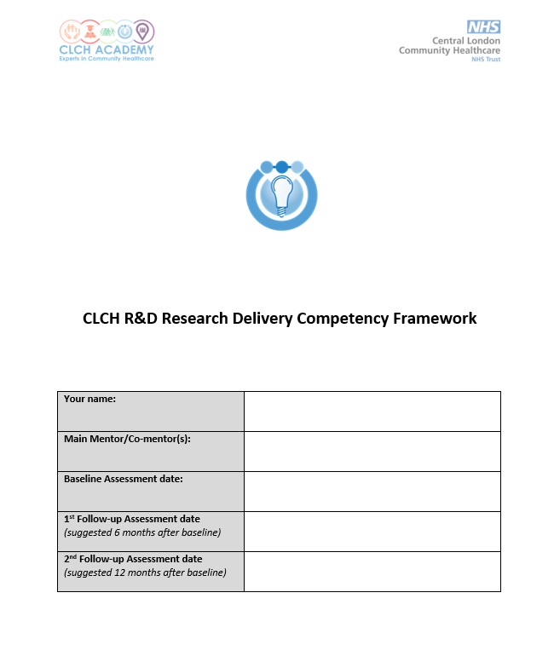
CLCH R&D Research Delivery Competency Framework
Trust Research Governance Committee
28/05/2025

Slide 2
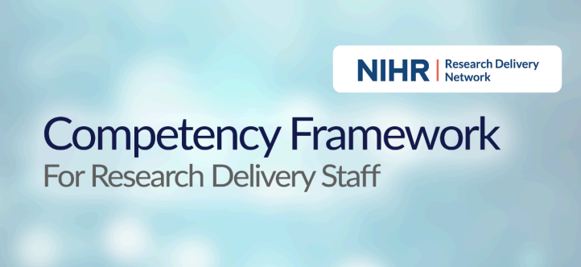
Adapted from the NIHR version 3.1 November 2024
Includes 4 modules
Initially developed to NIHR staff and expanded to include NHS professionals.

Slide 3
Competency Framework for Research Delivery Staff
Purpose: to enable staff to assess their research skills development in the community.
Target: This document is not limited to the use of research delivery staff. Research coordinators, managers, facilitators, fellows and non-research professionals are welcome to use.
Understand more clearly what is required from them
Document their knowledge, skills, attributes and experience
Identify learning needs and interests
Provide evidence of achievement to support annual appraisals & promote fair and consistent assessment
Demonstrate adherence to Good Clinical Practice (GCP)
Recognise the contribution of every member of the research team
Identify opportunities for personal development, training and career progression
Can be used as evidence for health profession revalidation portfolio
May form the basis for progression through NHS gateways (e.g. Agenda for Change)

Slide 4


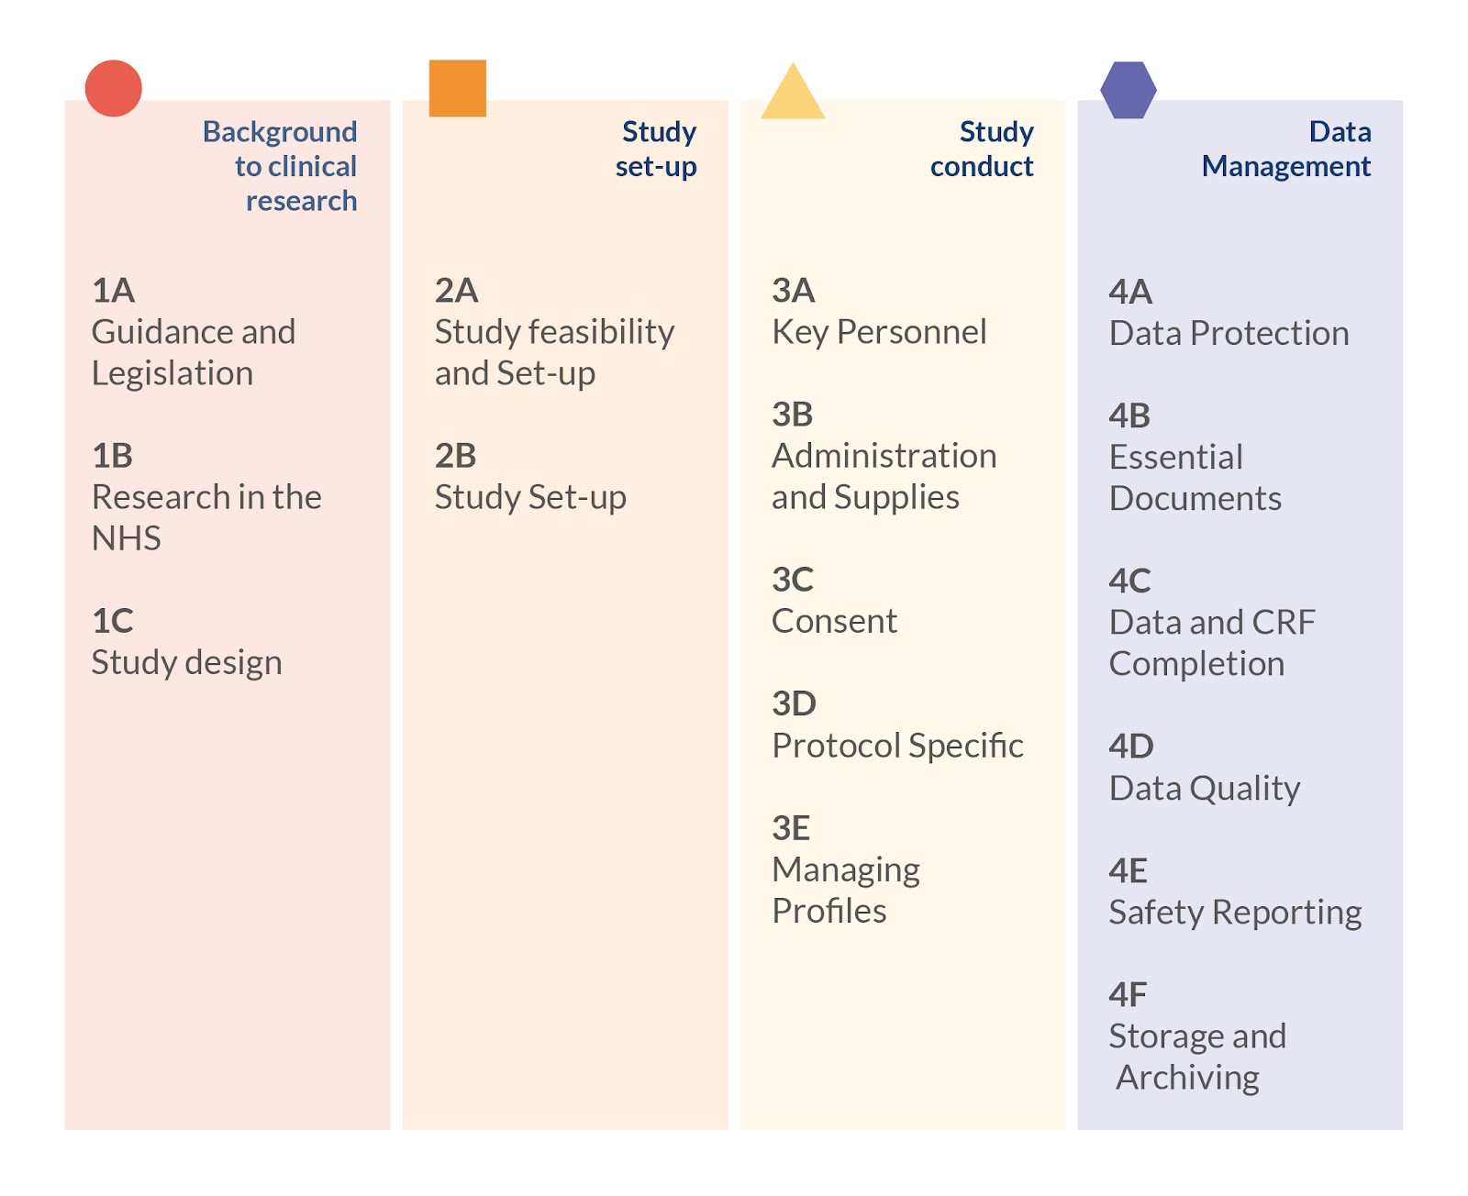

Doing research in the community
5A
Clinical community research
- Demonstrate an understanding of community needs and apply the clinical research principles to the community care setting.

Slide 5
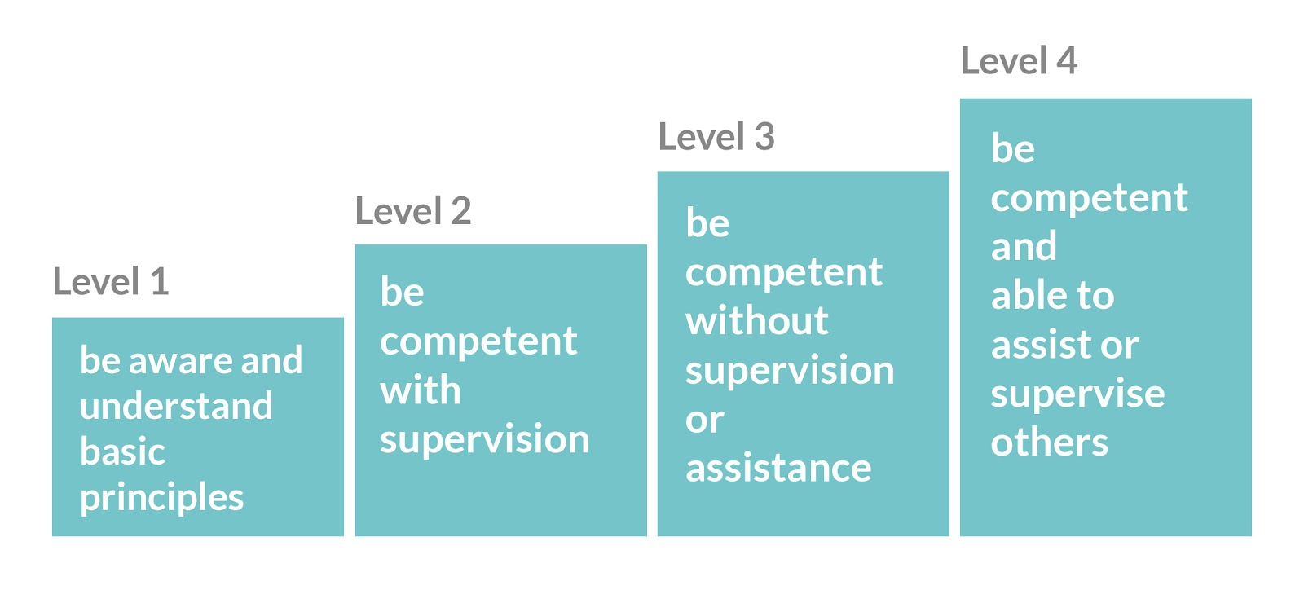
Assessment

Slide 6
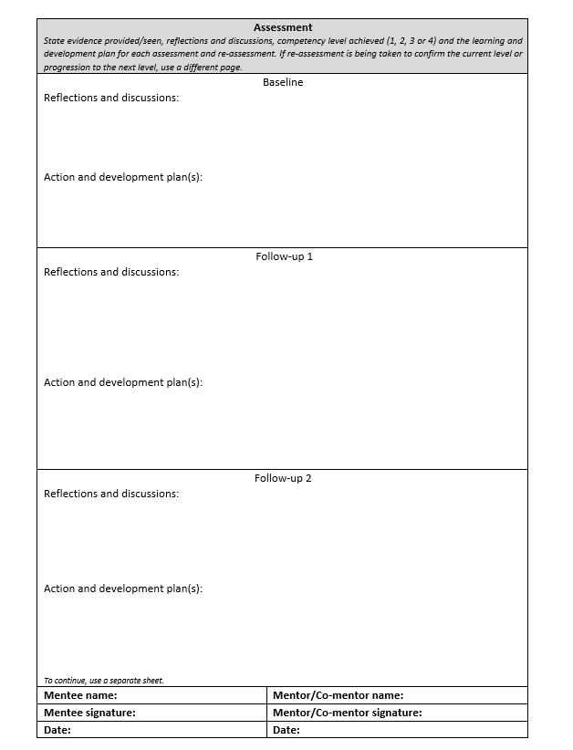
Mentee and Mentor collaboration

Slide 7
Thank you
Suggestions
Archiving and destruction.
Matrix with levels.

